Slide 1

AIRPLANE CRASH ANALYSIS
VANMATHI K

Slide 2


Slide 3
OBJECTIVES
1.Temporal Analysis
2.Geospatial Analysis
3.Operator Performance
4.Aircraft Analysis
5.Fetality Trends
6.Route Analysis

Slide 4
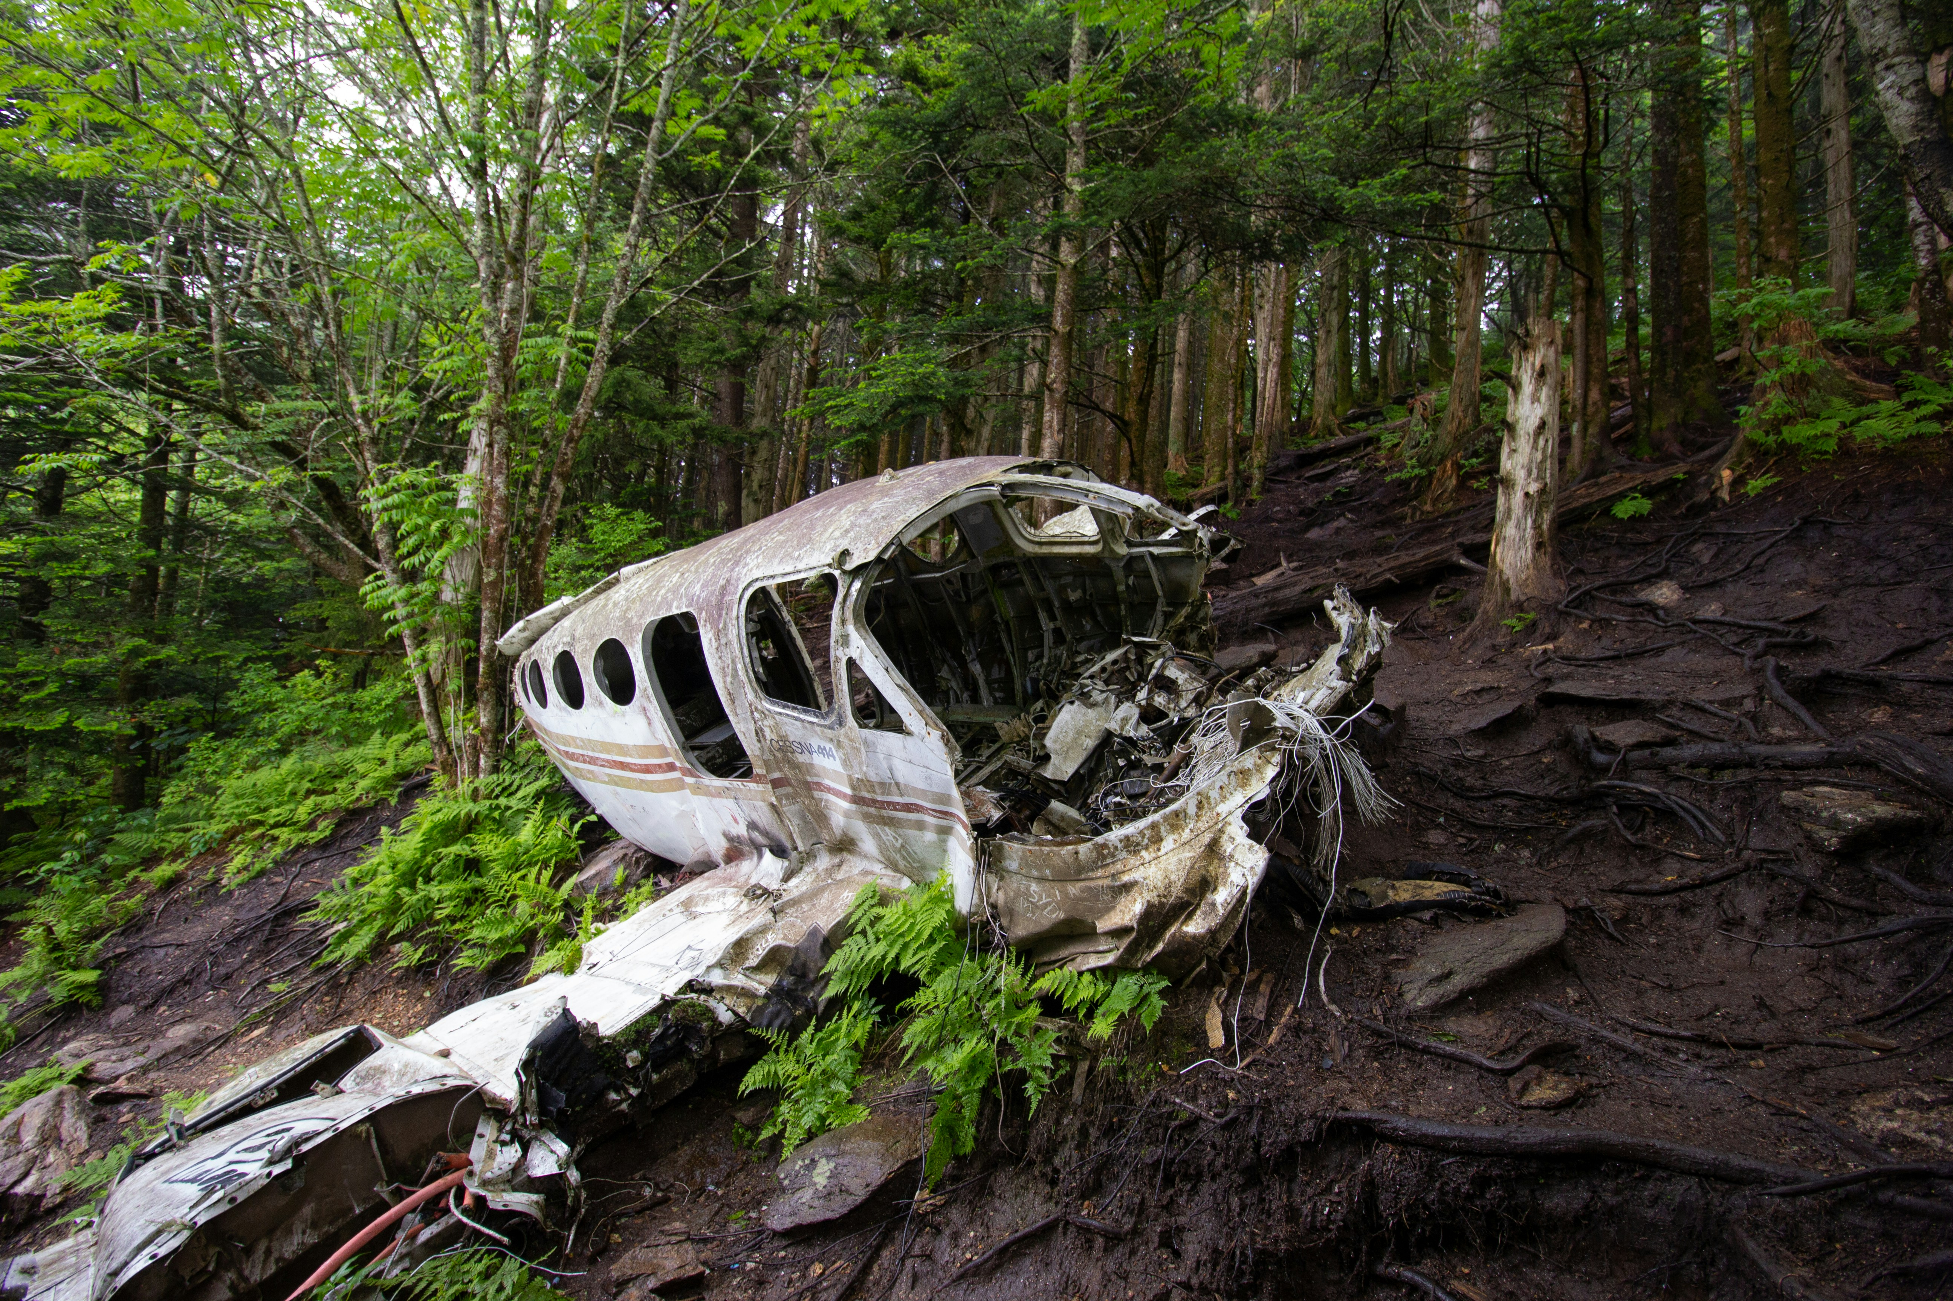
DATA CLEANING
In the data cleaning process, it's essential to address missing values effectively.
One common approach is to transform null values to 0, providing a placeholder while maintaining consistency in the dataset.
Additionally, separating a new year column from the date column can enhance analysis by enabling easier temporal analysis. Moreover, adding a new column such as 'Country' facilitates more granular analysis, allowing insights to be drawn based on geographical factors.

Slide 5

PROJECT LINK
https://github.com/VANMATHIK237/Mentorness-Data-Analyst-Intern

Slide 6

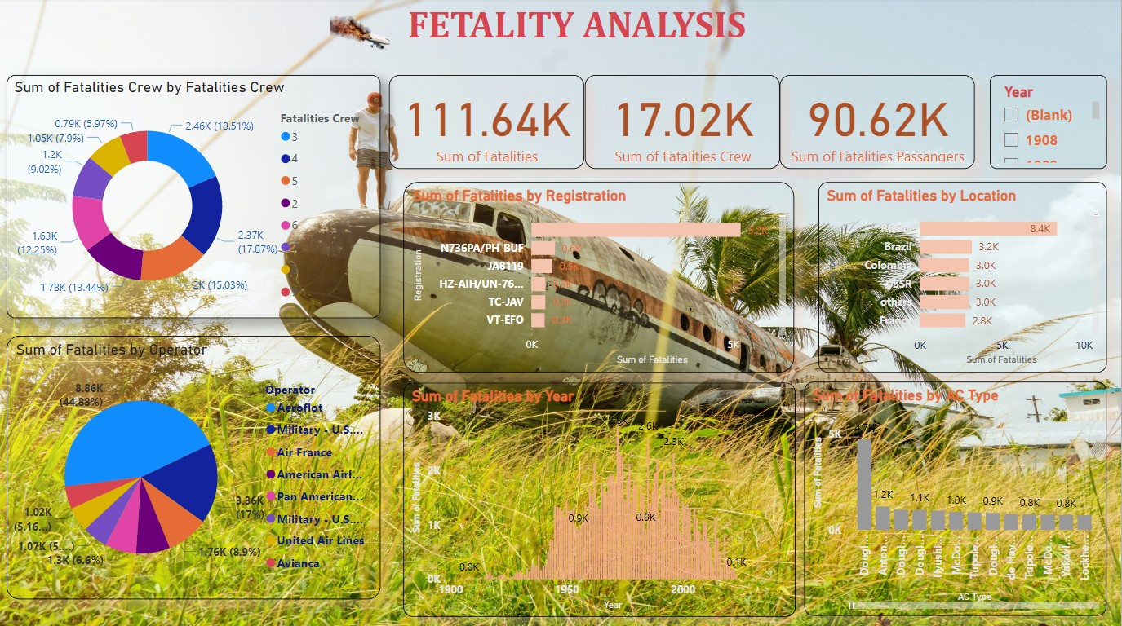

Slide 7
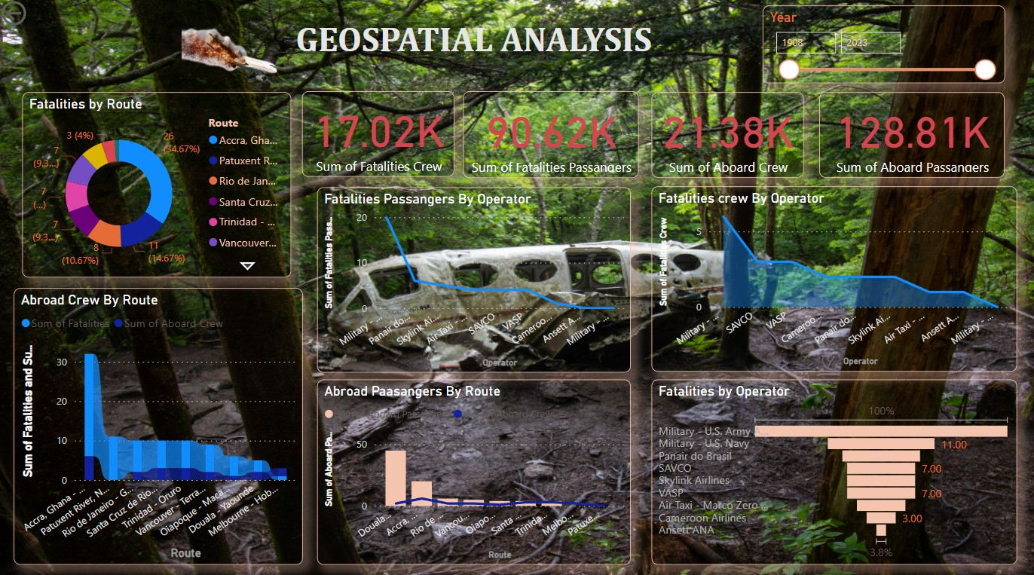

Slide 8

THANK YOU!

